Slide 1
Lesson 3: Convolutional Neural Networks
Eric Keilty

Slide 2
Recap of What We Have Gone Over
Linear Classifiers: D inputs to 1 output + a nonlinear activation function
Linear Regression (classification): linear activation function + MSE Loss function for gradient updates
Logistic Regression (classification): sigmoid activation function + Binary Cross Entropy Loss (Log Loss) function for gradient updates
Multi-Layer Preceptrons: D inputs to k outputs with any number of hidden layers between each containing any number of neurons. Each layer is fully connected to its neighboring layers.
Multilabel Classification: softmax activation function + Cross Entropy Loss (Log Loss) function for gradient updates

Slide 3
The Computer Vision Problem
Goal is to replicate the human ability of processing visual data
Sub-domains
scene reconstruction
event detection
video tracking
object recognition
3D pose estimation
learning, indexing
motion estimation
3D scene modeling
image restoration
For simplicity we will focus on the task of image classification, i.e. determining what the object is in the image from a predetermined list of possibilities

Slide 4



Image Recognition: High-Level Architecture
Some
Neural Network
$$\hat{y}$$
$$y$$
1 if it’s a dog and 0 if it’s not a dog

Slide 5
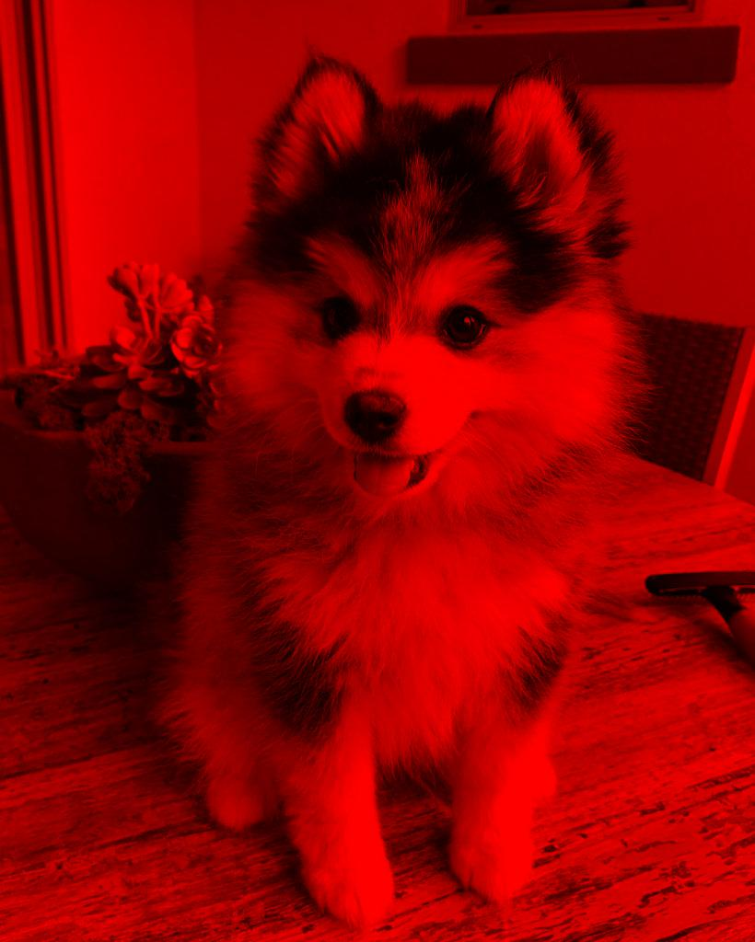
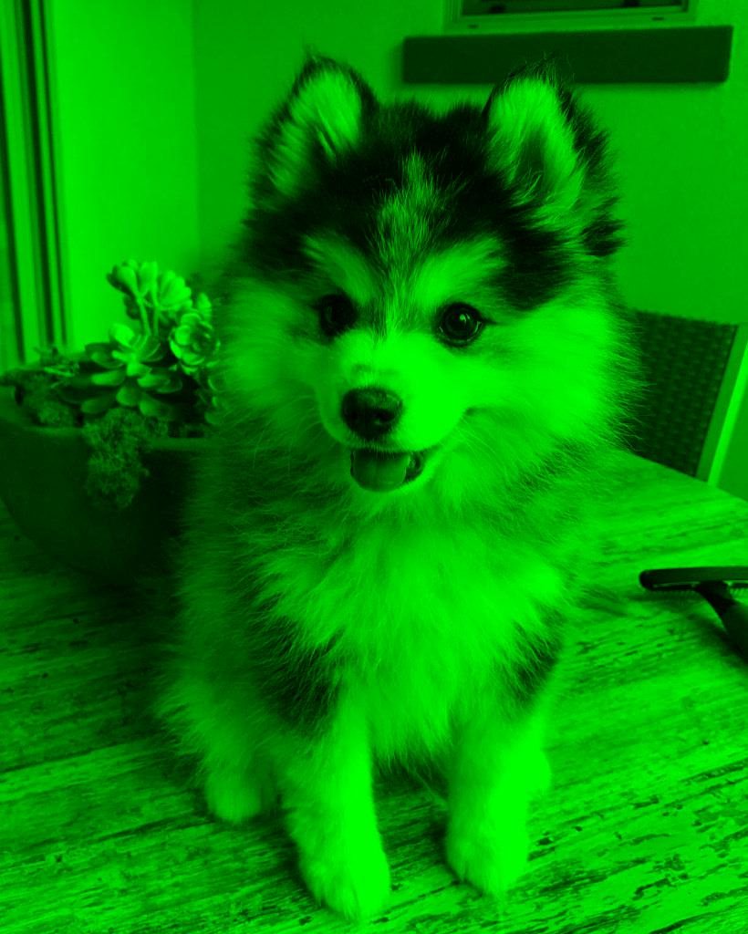
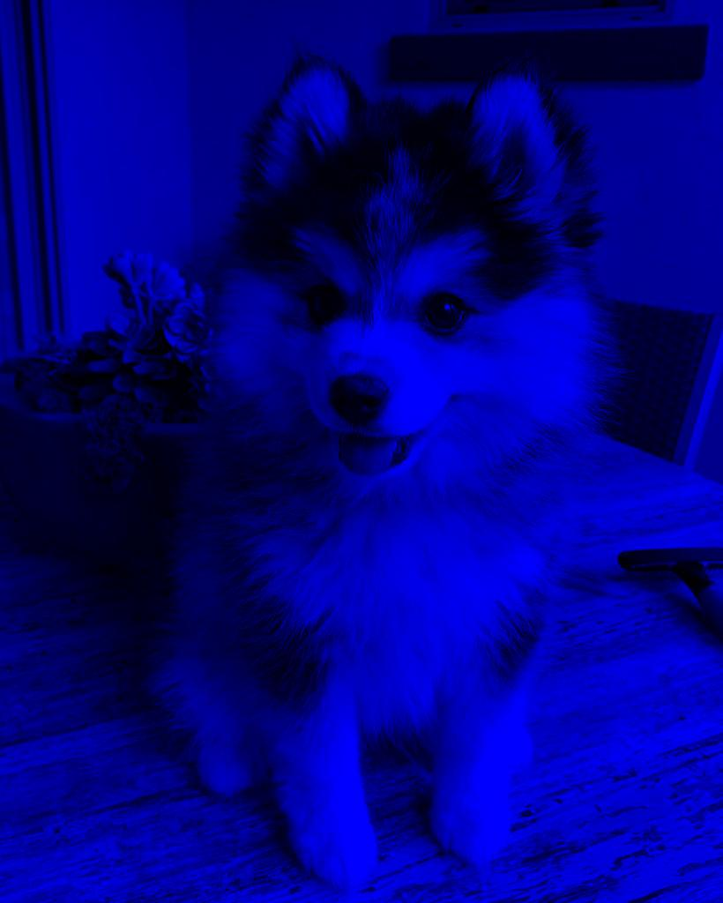
Image Recognition: Inputs
An image is a 3D array of pixel values
The values either range from 0 to 255 or 0 to 1 (depending on the image format)
Height and Width are the obvious 2 dimensions
Each pixel has 3 different channels: Red, Green, and Blue (the 3rd dimension)

Slide 6
Image Recognition: Naïve Approach
We take the 3D image and flatten it to a 1D input

Slide 7

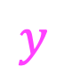
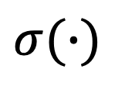
Image Recognition: Naïve Approach
∑
$$z$$
$$σ(∙)$$
$$\hat{y}$$
$$y$$
MLP
What are the potential Problems with this approach?

Slide 8


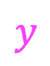



Image Recognition: Naïve Approach #2
$$H_{1}^{(1)}$$
$$H_{1}^{(L)}$$
Fully Connected
Fully Connected
$$\hat{y}$$
$$y$$
$$H_{d^{(1)}}^{(1)}$$
$$H_{d^{(L)}}^{(L)}$$
What are the potential Problems with this approach?

Slide 9

Image Recognition: Naïve Approach Problems
Too Many Parameters!
Suppose our first hidden layer had 100 nodes.
How many weights would be between the input and this layer?
$\left(1024 ∙ 820\right)∙100=83,968,000$
That’s a lot of parameters just for the first layer!
1024
820

Slide 10


Image Recognition: Naïve Approach Problems
Non-locality
$$H_{1}$$
Do these pixels have anything to do with each other?
$$H_{100}$$

Slide 11
Image Recognition: Naïve Approach Problems
Translation
Why is this a problem for our architecture?

Slide 12

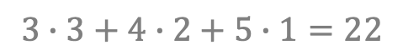

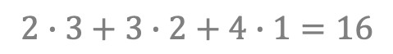
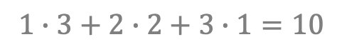

The Convolution: 1D Example
$${(a ∗ b)}_{t} =\sum_{τ}{a_{τ}}b_{t−τ}$$
1 | 2 | 3 | 4 | 5
3 | 2 | 1
$$1∙3+2∙2+3∙1=10$$
1 | 2 | 3 | 4 | 5
1 | 2 | 3 | 4 | 5
$$∗$$
1 | 2 | 3
$$=$$
$$=$$
10 | 16 | 22
3 | 2 | 1
$$2∙3+3∙2+4∙1=16$$
input
kernel / filter
1 | 2 | 3 | 4 | 5
3 | 2 | 1
$$3∙3+4∙2+5∙1=22$$

Slide 13



The Convolution: 2D Example
$${(A ∗B)}_{st} =\sum_{σ}{\sum_{τ}{A_{στ}}B_{s−σ,t−τ}}$$
1 | 2 | 3 | 4 | 5
6 | 7 | 8 | 9 | 10
11 | 12 | 13 | 14 | 15
16 | 17 | 18 | 19 | 20
21 | 22 | 23 | 24 | 25
219 | 264 | 309
444 | 489 | 534
669 | 714 | 759
1 | 2 | 3
4 | 5 | 6
7 | 8 | 9
$$∗$$
$$=$$

Slide 14

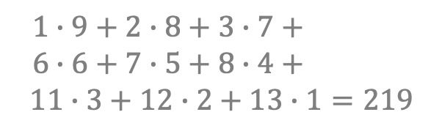

The Convolution: 2D Example
$${(A ∗B)}_{st} =\sum_{σ}{\sum_{τ}{A_{στ}}B_{s−σ,t−τ}}$$
1 | 2 | 3 | 4 | 5
6 | 7 | 8 | 9 | 10
11 | 12 | 13 | 14 | 15
16 | 17 | 18 | 19 | 20
21 | 22 | 23 | 24 | 25
219
1 | 2 | 3
4 | 5 | 6
7 | 8 | 9
$$1∙9+2∙8+3∙7+$$
$$6∙6+7∙5+8∙4+$$
$$11∙3+12∙2+13∙1=219$$
$$∗$$
$$=$$

Slide 15
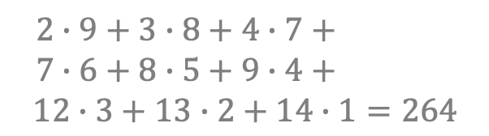
The Convolution: 2D Example
$${(A ∗B)}_{st} =\sum_{σ}{\sum_{τ}{A_{στ}}B_{s−σ,t−τ}}$$
1 | 2 | 3 | 4 | 5
6 | 7 | 8 | 9 | 10
11 | 12 | 13 | 14 | 15
16 | 17 | 18 | 19 | 20
21 | 22 | 23 | 24 | 25
219 | 264
1 | 2 | 3
4 | 5 | 6
7 | 8 | 9
$$2∙9+3∙8+4∙7+$$
$$7∙6+8∙5+9∙4+$$
$$12∙3+13∙2+14∙1=264$$
$$∗$$
$$=$$

Slide 16
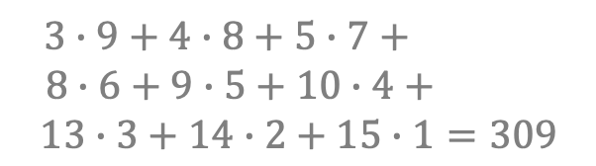
The Convolution: 2D Example
$${(A ∗B)}_{st} =\sum_{σ}{\sum_{τ}{A_{στ}}B_{s−σ,t−τ}}$$
1 | 2 | 3 | 4 | 5
6 | 7 | 8 | 9 | 10
11 | 12 | 13 | 14 | 15
16 | 17 | 18 | 19 | 20
21 | 22 | 23 | 24 | 25
219 | 264 | 309
1 | 2 | 3
4 | 5 | 6
7 | 8 | 9
$$3∙9+4∙8+5∙7+$$
$$8∙6+9∙5+10∙4+$$
$$13∙3+14∙2+15∙1=309$$
$$∗$$
$$=$$

Slide 17
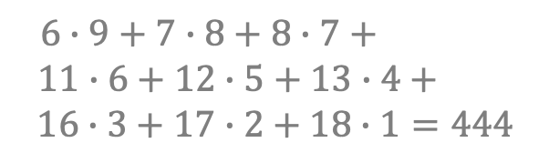
The Convolution: 2D Example
$${(A ∗B)}_{st} =\sum_{σ}{\sum_{τ}{A_{στ}}B_{s−σ,t−τ}}$$
1 | 2 | 3 | 4 | 5
6 | 7 | 8 | 9 | 10
11 | 12 | 13 | 14 | 15
16 | 17 | 18 | 19 | 20
21 | 22 | 23 | 24 | 25
219 | 264 | 309
444
1 | 2 | 3
4 | 5 | 6
7 | 8 | 9
$$6∙9+7∙8+8∙7+$$
$$11∙6+12∙5+13∙4+$$
$$16∙3+17∙2+18∙1=444$$
$$∗$$
$$=$$

Slide 18
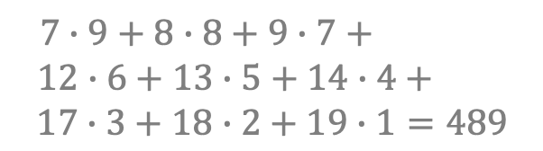
The Convolution: 2D Example
$${(A ∗B)}_{st} =\sum_{σ}{\sum_{τ}{A_{στ}}B_{s−σ,t−τ}}$$
1 | 2 | 3 | 4 | 5
6 | 7 | 8 | 9 | 10
11 | 12 | 13 | 14 | 15
16 | 17 | 18 | 19 | 20
21 | 22 | 23 | 24 | 25
219 | 264 | 309
444 | 489
1 | 2 | 3
4 | 5 | 6
7 | 8 | 9
$$7∙9+8∙8+9∙7+$$
$$12∙6+13∙5+14∙4+$$
$$17∙3+18∙2+19∙1=489$$
$$∗$$
$$=$$

Slide 19
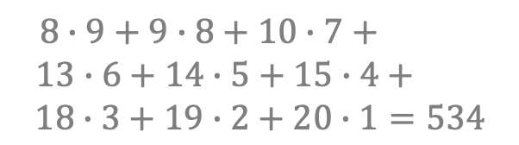
The Convolution: 2D Example
$${(A ∗B)}_{st} =\sum_{σ}{\sum_{τ}{A_{στ}}B_{s−σ,t−τ}}$$
1 | 2 | 3 | 4 | 5
6 | 7 | 8 | 9 | 10
11 | 12 | 13 | 14 | 15
16 | 17 | 18 | 19 | 20
21 | 22 | 23 | 24 | 25
219 | 264 | 309
444 | 489 | 534
1 | 2 | 3
4 | 5 | 6
7 | 8 | 9
$$8∙9+9∙8+10∙7+$$
$$13∙6+14∙5+15∙4+$$
$$18∙3+19∙2+20∙1=534$$
$$∗$$
$$=$$

Slide 20
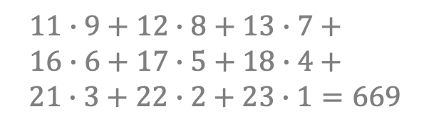
The Convolution: 2D Example
$${(A ∗B)}_{st} =\sum_{σ}{\sum_{τ}{A_{στ}}B_{s−σ,t−τ}}$$
1 | 2 | 3 | 4 | 5
6 | 7 | 8 | 9 | 10
11 | 12 | 13 | 14 | 15
16 | 17 | 18 | 19 | 20
21 | 22 | 23 | 24 | 25
219 | 264 | 309
444 | 489 | 534
669
1 | 2 | 3
4 | 5 | 6
7 | 8 | 9
$$11∙9+12∙8+13∙7+$$
$$16∙6+17∙5+18∙4+$$
$$21∙3+22∙2+23∙1=669$$
$$∗$$
$$=$$

Slide 21
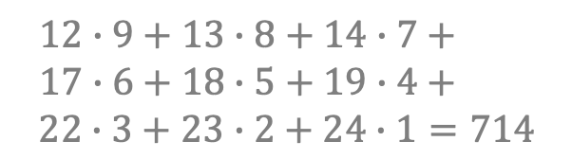
The Convolution: 2D Example
$${(A ∗B)}_{st} =\sum_{σ}{\sum_{τ}{A_{στ}}B_{s−σ,t−τ}}$$
1 | 2 | 3 | 4 | 5
6 | 7 | 8 | 9 | 10
11 | 12 | 13 | 14 | 15
16 | 17 | 18 | 19 | 20
21 | 22 | 23 | 24 | 25
219 | 264 | 309
444 | 489 | 534
669 | 714
1 | 2 | 3
4 | 5 | 6
7 | 8 | 9
$$12∙9+13∙8+14∙7+$$
$$17∙6+18∙5+19∙4+$$
$$22∙3+23∙2+24∙1=714$$
$$∗$$
$$=$$

Slide 22
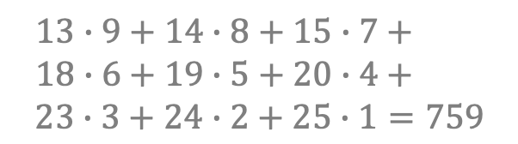
The Convolution: 2D Example
$${(A ∗B)}_{st} =\sum_{σ}{\sum_{τ}{A_{στ}}B_{s−σ,t−τ}}$$
1 | 2 | 3 | 4 | 5
6 | 7 | 8 | 9 | 10
11 | 12 | 13 | 14 | 15
16 | 17 | 18 | 19 | 20
21 | 22 | 23 | 24 | 25
219 | 264 | 309
444 | 489 | 534
669 | 714 | 759
1 | 2 | 3
4 | 5 | 6
7 | 8 | 9
$$13∙9+14∙8+15∙7+$$
$$18∙6+19∙5+20∙4+$$
$$23∙3+24∙2+25∙1=759$$
$$∗$$
$$=$$

Slide 23
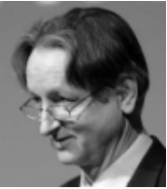


Applying Convolution to Images
What does this kernel / filter do?
0 | 1 | 0
1 | 4 | 1
0 | 1 | 0
$$∗$$
$$=$$
$$?$$

Slide 24
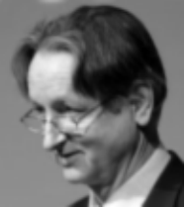
Applying Convolution to Images
What does this kernel / filter do?
0 | 1 | 0
1 | 4 | 1
0 | 1 | 0
$$∗$$
$$=$$

Slide 25
Applying Convolution to Images
What does this kernel / filter do?
0 | -1 | 0
-1 | 8 | -1
0 | -1 | 0
$$∗$$
$$=$$
$$?$$

Slide 26

Applying Convolution to Images
What does this kernel / filter do?
0 | -1 | 0
-1 | 8 | -1
0 | -1 | 0
$$∗$$
$$=$$

Slide 27
Applying Convolution to Images
What does this kernel / filter do?
0 | -1 | 0
-1 | 4 | -1
0 | -1 | 0
$$∗$$
$$=$$
$$?$$

Slide 28
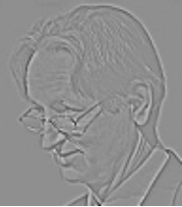
Applying Convolution to Images
What does this kernel / filter do?
0 | -1 | 0
-1 | 4 | -1
0 | -1 | 0
$$∗$$
$$=$$

Slide 29
Applying Convolution to Images
What does this kernel / filter do?
1 | 0 | -1
2 | 0 | -2
1 | 0 | -1
$$∗$$
$$=$$
$$?$$

Slide 30
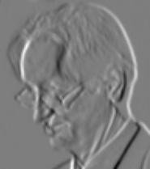
Applying Convolution to Images
What does this kernel / filter do?
1 | 0 | -1
2 | 0 | -2
1 | 0 | -1
$$∗$$
$$=$$

Slide 31
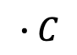
The Basic Components of a CNN
$$∙C$$
3 x 3 x 3
C x 2 x 2
C x 511 x 409
3 x 1024 x 820
C x 1022 x 818
Convolutional Layer
Max Pooling
Bias

Slide 32
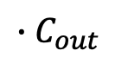


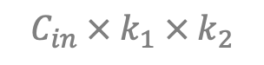

Convolution Dimensional Analysis
$$∙C_{out}$$
$$C_{in} × k_{1} × k_{2}$$
$$C_{in} × H_{in} × W_{in}$$
$$C_{out} × H_{out} × W_{out}$$
$$H_{out}=\frac{H_{in}+2∙padding −dilation∙\left(k_{1} −1\right)−1}{stride}+1$$
Likewise for W_{in} , W_{out} , and k₂

Slide 33
What is Padding, Dilation, and Stride?
A picture says 1000 words, but you really can’t beat an interactive animation: https://ezyang.github.io/convolution-visualizer/index.html
Padding: adding a boarder of all 0’s (default 0)
Dilation: skipping pixels in the input between pixels in the kernel within a single convolution operation (default 1)
Stride: skipping pixels in the input between convolutions operations (default 1)

Slide 34
What is Max Pooling?
-10 | 21 | -2 | 18
26 | 2 | 17 | 11
35 | -7 | 41 | 48
16 | 31 | -7 | -1
26 | 18
35 | 48
2 x 2
Max Pool
Why do we do this?
Why don’t we Min Pool or Average Pool?

Slide 35
Advantages of CNNs
Weight sharing drastically reduces the number of parameters (more memory efficient)
Highly parallelizable (more computationally efficient)
The output is translation equivariant, which helps the model generalize in certain applications (such as image classification)
Takes advantage of locality, which speeds up learning in certain applications (such as image classification)
They are excellent feature extractors, which makes pre-trained CNN models very useful

Slide 36
CNN and MLP Equivalence
Any CNN can be converted to an MLP
The kernel could be thought of as a fully connected unit with mostly 0 weights
This is why CNNs are sometimes called spare representations
Convert CNN to MLP Procedure
For each convolutional layer
Flatten the input and the output
For each kernel, add an additional set of output layers
Each kernel represents a fully connected unit from all inputs to its corresponding set of outputs where all weights are 0 except for the weights in the locations of the kernel occupies in the input
You may now appreciate how much information is being store in even a small CNN kernel

Slide 37
Assignment 4a
We are classifying an ‘X’ again! Except this time the ‘X’ (which is a 3x3 feature) can be anywhere in a 5x5 grid
1 | 0 | 1 | 0 | 0
0 | 1 | 0 | 0 | 0
1 | 0 | 1 | 0 | 0
0 | 0 | 0 | 0 | 0
0 | 0 | 0 | 0 | 0
1 | 1 | 1 | 1 | 1
1 | 1 | 1 | 0 | 1
1 | 1 | 0 | 1 | 0
1 | 1 | 1 | 0 | 1
1 | 1 | 1 | 1 | 1

Slide 38

Assignment 4a: Part 1
Can you find a hand-crafted solution?
∑
flatten
$$\hat{y}$$
3 x 3
3 x 3
5 x 5
9
weights
bias

Slide 39
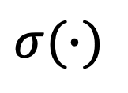
Assignment 4a: Part 2
Implement this architecture in PyTorch
ReLU
flatten
$$σ(∙)$$
$$\hat{y}$$
3 x 3
3 x 3
3 x 3
5 x 5
9
weights
bias

Slide 40
Assignment 4a: Part 3
Try to implement an MLP model that can classify an ‘X’ with greater than 90% accuracy
This is not easy, and I’m not even sure if it can be consistently achieved

Slide 41
Assignment 4b
We will be famous MNIST (Modified National Institute of Standards and Technology), which consists of 70,000 images (28x28) of handwritten digits
This is a famous dataset that is used as a benchmark for a lot of different architectures. The top models can get 99.7% accuracy
Your goal is to get above 90%

Slide 42
Assignment 4b: Part 1
You will implement the following CNN architecture in PyTorch. This is the famous LeNet architecture (1998)
5 x 5
Convolution
2 x 2
Max Pool
1 x 28 x 28
6 x 14 x 14
6 x 28 x 28

Slide 43
Assignment 4b: Part 1
You will implement the following CNN architecture in PyTorch. This is the famous LeNet architecture (1998)
5 x 5
Convolution
2 x 2
Max Pool
16 x 5 x 5
6 x 14 x 14
16 x 10 x 10

Slide 44





Assignment 4b: Part 1
You will implement the following CNN architecture in PyTorch. This is the famous LeNet architecture (1998)
$$z_{1}$$
$${\hat{y}}_{1}$$
flatten
Fully Connected
Fully Connected
Fully Connected
Softmax$(∙)$
$$z_{10}$$
$${\hat{y}}_{10}$$
16 x 5 x 5
120
84
400

Slide 45
Assignment 4b: Part 2
Try to implement an MLP architecture that can classify handwritten digits. Attempt to get over 80%
This should not be too difficult
Analyze the number of parameters your MLP required compared to the CNN

